Slide 1
QMS, ISO 9001:2015 & IATF 16949:2016
Introduction And Awareness
Doing the right things in the right way
Faculty : Ashish Bhuskat
ashish.bhuskat@advik.co.in
Date : 12 Jul. 2018

Slide 2
Contents
Introduction to Quality Management System (QMS)
Basics of Quality Management System (QMS)
Introduction to ISO Organizations for Automotive
Transition of ISO 9001:2015
Changes in ISO 9001:2015 Compared to ISO 9001:2008
Transition of IATF 16949:2016
Changes in IATF 16949:2016 Compared to ISO 9001:2008
PDCA Methodology – ISO/TS & IATF
High Level Structure of ISO 9001:2015
Specific requirements of ISO 9001:2015
Specific requirements of IATF 16949: 2016
ISO 9001:2015 and IATF 16949:2016 Clauses and Requirements

Slide 3
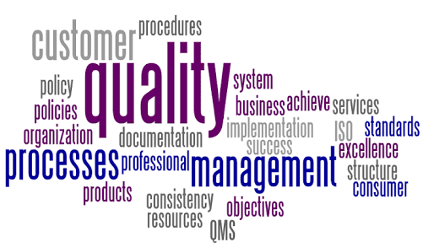
What do you know about QMS?

Slide 4
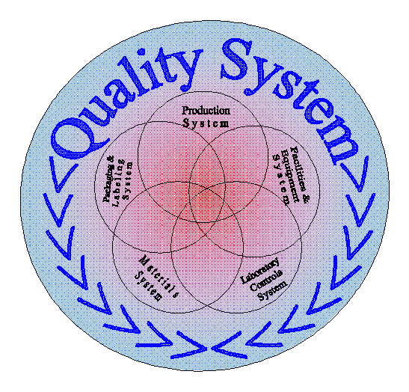
What do you understand by QMS?
Quality Management System:
A Quality Management System is a collection of -
Policies,
Processes
Procedures
Plans
Resources
Practices
Responsibilities
Authorities
To achieve product and services quality levels, customer satisfaction and company objectives.

Slide 5
What do you understand by QMS?
Quality System
Quality Assurance
Quality Control

Slide 6
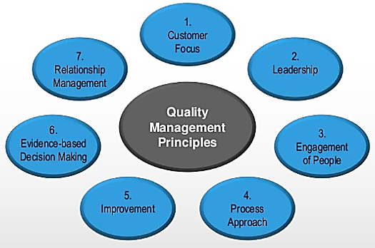
Quality Management Principles
Customer Focus
Leadership
People Involvement
Process Approach
Systems Approach
Continual improvement
Factual Approach to Decision Making
Mutually Beneficial Supplier Relationships

Slide 7
What do you understand by QMS?
L1
Level 1 (L1)
Policy,
Vision, Mission,
QM
L2
Level 2 (L2)
Procedures
L3
Level 3 (L3)
Forms, Formats, Work Instructions, Guidelines, Standards, Specification, Checklists, Standards, Training Material, etc.
L4
Level 4 (L4)
All Filled up and Completed Documents Stored in Hard / Soft Format, etc.

Slide 8
Introduction of Quality Documentation?
Why everyone is approaching to Standard Operating Procedures (SOP)?
What is a difference between “Procedure” and “Work Instruction” ?
1. Quality Policy (Objectives of the Organization)
2. Vision / Mission (Where we want to see ourselves in future)
3. Quality Manual (Collection of Principles from Standards)
4. Quality Procedures (Set of requirements from functions)
5. Forms / Formats (Structured form if Information)
6. Checklist / Check Sheet (What is the difference?)
7. Standards (What something should be?)
8. Work Instructions (How to perform specific Task Correctly?)
9. Specifications (Statement of precise requirement)

Slide 9
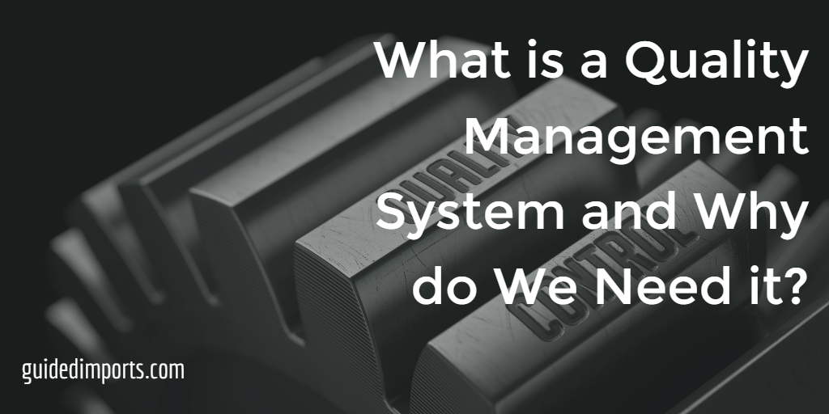
Why Industries need QMS?
QMS affects every aspect of an organization's performance.
To meet the customer’s requirements
Counter meeting organization's requirements, which ensure compliance with regulations
To utilize cost and resources efficiently
Creating room for expansion, growth and profit
Increasing Brand Value and Reputation of the Organization

Slide 10
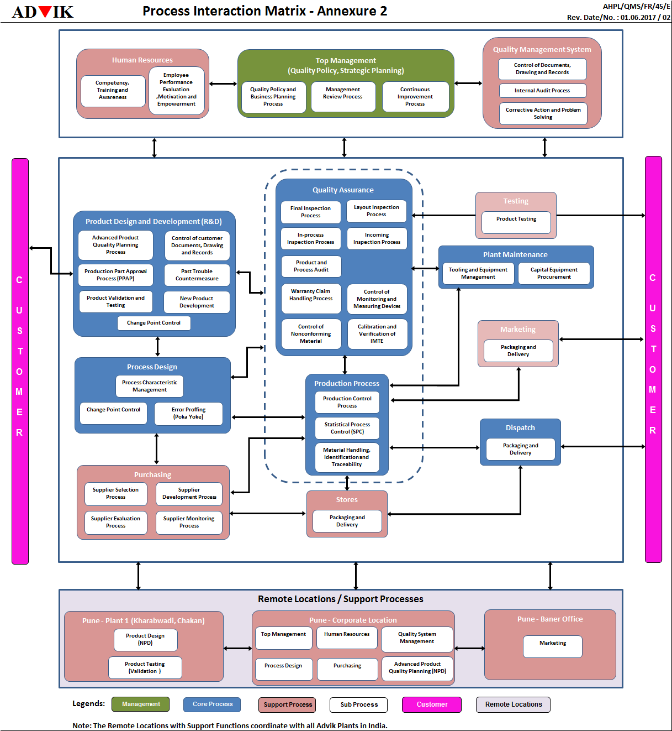
Process Map /Interaction Matrix
Process Interaction Matrix
Scope of QMS
Interaction of Processes with each other
Categorization of processes into Management Oriented Processes (MOP), Customer Oriented Processes (COP) and Support Oriented Processes (SOP)
Flow of processes from Inputs by Customer to Out to the customer.

Slide 11
Process Approach

Slide 12
Process Approach
Continuous Improvement
Quality Policies
Quality Standards/
Specifications
Process
Quality Manual
Quality Procedures
Customer Satisfaction
Customer needs & Expectations
Document
Forms / Formats
Records
Monitoring & Tracking

Slide 13
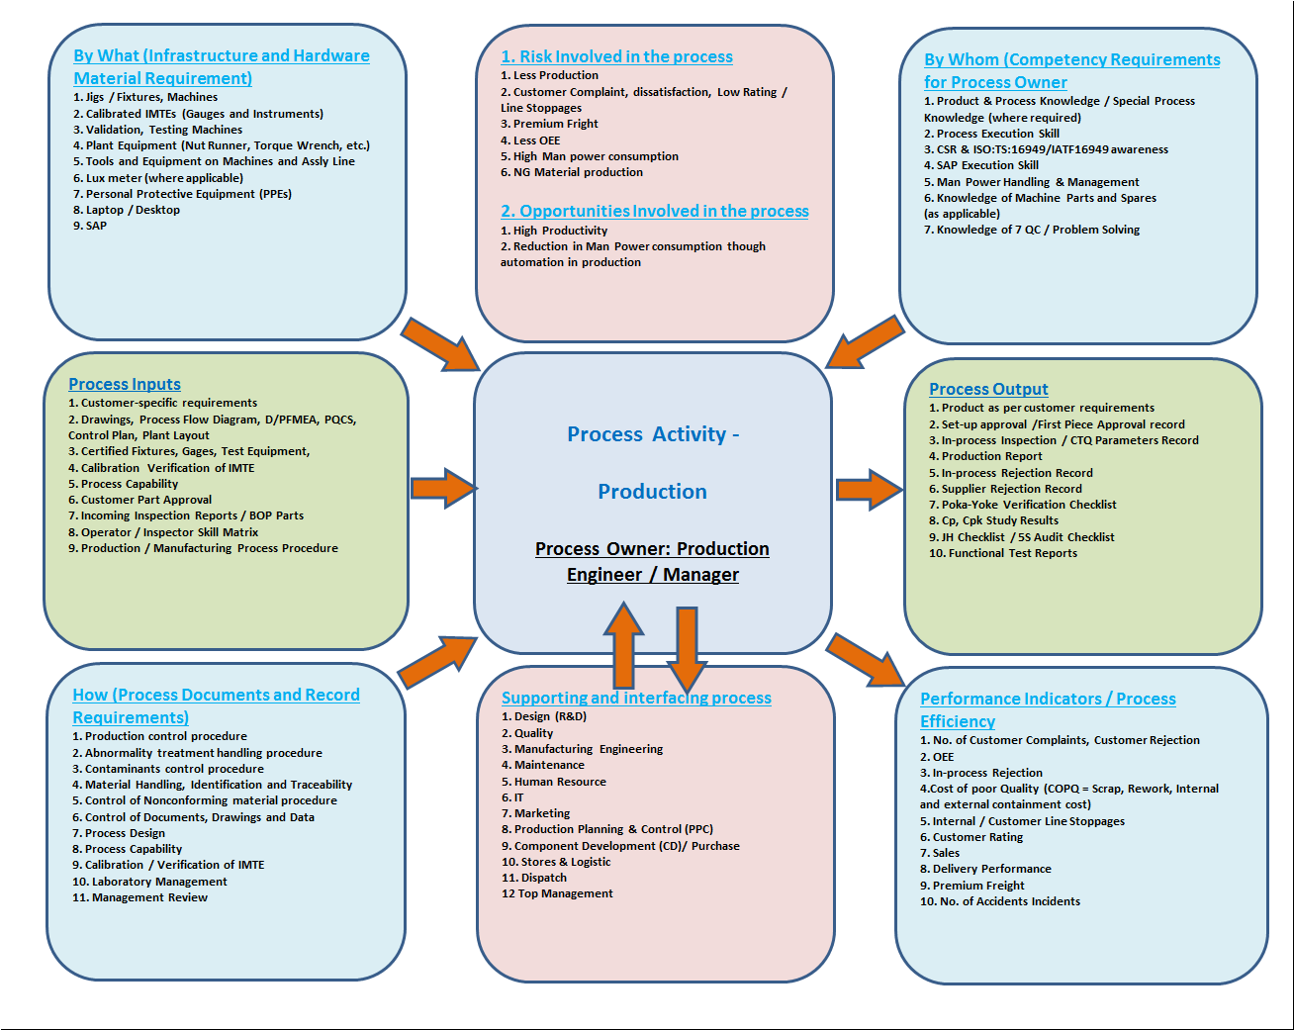
Turtle Diagram

Slide 14
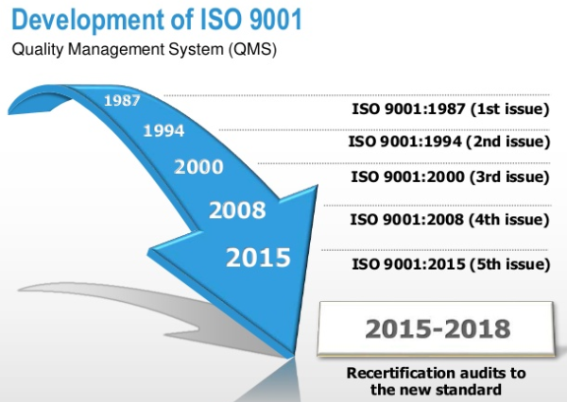
Development of ISO 9001: 2015

Slide 15
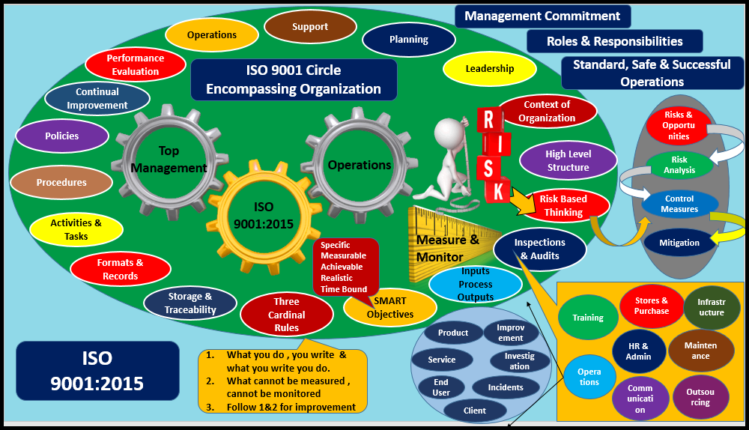
What’s new in ISO 9001: 2015?

Slide 16
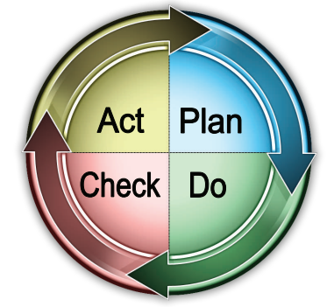
Process Approach & High Level Structure (HLS)
4
Context of the Organization
4
Leadership
5
10
6
Planning
A
P
6
Support
7
Leadership
Operation
8
5
Performance Evaluation
9
C
D
Improvement
7
10
9
8

Slide 17
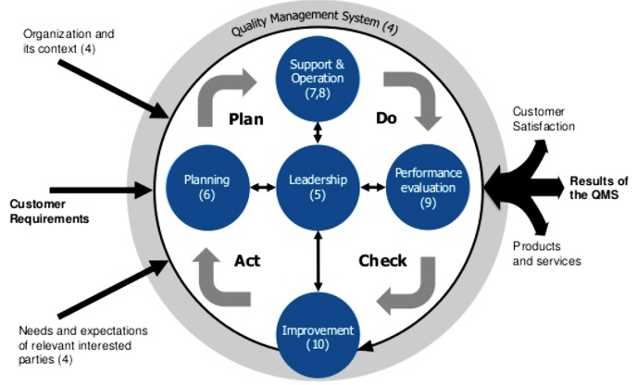
PDCA Methodology

Slide 18
Three Key Organizations
1. IATF – International Automotive Task Force
2. IAOB - International Automotive Oversight Bureau
3. AIAG – Automotive Industries Action Group
Publishing standards and offering educational conferences and training.
IATF
IAOB
AIAG
Auditing Bodies
Industry-1
Industry-4
Industry-2
Industry-3

Slide 19
Purpose of the IATF Organization
Develop consensus for international quality system requirements (automotive)
Develop policy & procedure for registration
Provide appropriate training to CBs
Serve as formal liaison

Slide 20
IATF Members
Vehicle manufacturers:
8 Subscribers-
BMW,
Daimler Chrysler,
FIAT,
Ford Motor,
GM,
PSA (French Car Mfg.),
Renault,
Volkswagen
Industry trade organizations:
AIAG – Automotive Industry Action Group
ANFIA (Italy)- National Association of the Automobile Industry (Associazione Nazionale Fra Industrie Automobilistiche)
FIEV (France)- French Vehicle Equipment Industries Association (Fédération des Industries des Equipements pour Véhicules)
SMMT (UK), VDA (Germany), ZF (Germany)
Guest members: JAMA - Japan Automobile Manufacturers Association

Slide 21
IAOB - International Automotive Oversight Bureau
ANFIA, IAOB, IATF-FRANCE, SMMT, VDA-QMC
Implementation of IATF registration scheme and rules via a common process
Witness audits
Auditor qualification training and exam
Monitor CB/auditor performance
Apply and implement IATF policy and decisions
Coordinate special projects and work teams
Develop sanctioned interpretations and recommendations for improvement
Database management

Slide 22
Goal of IATF 16949:2016
Goal of the IATF 16949 standard is the development of strong QMS that;
Provides for continual improvements
Emphasizes defect prevention
Promotes reduction of variation and waste throughout the supply chain.
Includes specific requirements and tools from the automotive industry (Development of Quality Management System)

Slide 23
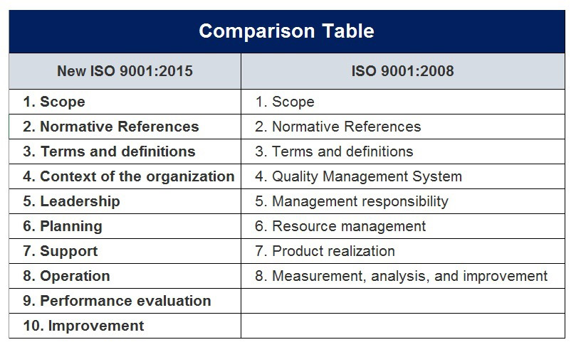
Comparison Between ISO 9001 :2015 & ISO 9001 :2008

Slide 24
Differences in Terminologies
ISO 9001:2008 | ISO 9001:2015
Products | Products and services
Exclusions | Not used (See Clause A.5 for clarification of applicability)
Management representative | Process Owners (Similar responsibilities and authorities are assigned but no requirement for a single management representative)
Documentation, quality manual, documented procedures, records | Documented information
Work environment | Environment for the operation of processes
Monitoring and measuring equipment | Monitoring and measuring resources
Purchased product | Externally provided products and services
Supplier | External provider

Slide 25
Comparison in Clauses and Sub-clauses
ISO 9001:2008 | ISO 9001:2015 | Changes/Remarks
0. Introduction | 0. Introduction | No Change
1. Scope | 1. Scope | No Change
2. Normative references | 2. Normative references | No Change
3. Terms and definitions | 3. Terms and definitions | New Definitions are added such as Aftermarket Part, Accessory Part, DFA, DFM, DFMA, Escalation, FTA, etc.
4. Quality Management System | 4. Context of the organization | Added Communication to External Parties and Risk Assessment
4.1 General Requirements | 4.1 Understanding the organization and its context
4.2 Documentation Requirements
4.2.1 General
4.2.2 Quality Manual | -
4.2.3 Control of Documents | 7.5 Documented Information | Records and Documents are now "Documented Information"
4.2.4 Control of Records | 7.5 Documented Information | Records and Documents are now "Documented Information"

Slide 26
Changes in Index
ISO 9001:2008 | ISO 9001:2015 | Changes/Remarks
5. Management Responsibility | 5. Leadership
5.1 Management Commitment
5.2 Customer Focus
5.3 Quality Policy
5.4 Planning | 6. Planning
5.4.1 Quality Objectives
5.4.2 Quality Management System Planning
5.5 Responsibility, Authority, and Communication
5.5.1 Responsibility and Authority
5.5.2 Management Representative |  | MR not required. Process Owners are the MRs of their respective functions.
5.5.3 Internal Communications
5.6 Management Review | 9.3 Management Review
5.6.1 General
5.6.2 Review Input
5.6.3 Review Output

Slide 27
Changes in Index
ISO 9001:2008 | ISO 9001:2015 | Changes/Remarks
6. Resource Management | 7. Support
6.1 Provision of Resources | 7.1 Resources
6.2 Human Resources | 7.2 Competence
6.2.1 General
6.2.2 Competence, Training, and Awareness | 7.2 Competence
6.3 Infrastructure
6.4 Work Environment
7. Product Realization | 8. Operation
7.1 Planning of Product Realization
7.2 Customer-Related Processes
7.2.1 Determination of Requirements Related to the Product
7.2.2 Review of Requirements Related to the Product
7.2.3 Customer Communication

Slide 28
Changes in Index
ISO 9001:2008 | ISO 9001:2015 | Changes/Remarks
7.3 Design and Development
7.3.1 Design and Development Planning
7.3.2 Design and Development Inputs
7.3.3 Design and Development Outputs
7.3.4 Design and Development Review
7.3.5 Design and Development Verification
7.3.6 Design and Development Validation
7.3.7 Control of Design and Development Changes
7.4 Purchasing
7.4.1 Purchasing Process
7.4.2 Purchasing Information
7.4.3 Verification of Purchased Product

Slide 29
Changes in Index
ISO 9001:2008 | ISO 9001:2015 | Changes/Remarks
7.5 Production and Service Provision
7.5.1 Control of Production and Service Provision
7.5.2 Validation of Processes for Production and Service Provision
7.5.3 Identification and Traceability | 8.5.2 Identification and traceability
7.5.4 Customer Property
7.5.5 Preservation of Product | 8.5.4 Preservation | Production and service
7.6 Control of Monitoring and Measuring Equipment
8. Measurement, Analysis, and Improvement | 9. Performance evaluation
8.1 General
8.2 Monitoring and Measurement
8.2.1 Customer Satisfaction
8.2.2 Internal Audit | 9.2 Internal Audit
8.2.3 Monitoring and Measurement of Processes
8.2.4 Monitoring and Measurement of Product

Slide 30
Changes in Index
ISO 9001:2008 | ISO 9001:2015 | Changes/Remarks
8.3 Control of Nonconforming Product
8.4 Analysis of Data
8.5 Improvement | 10 Improvement
8.5.1 Continual Improvement | 10.3 Continual improvement
8.5.2 Corrective Action | 10.2 Nonconformity and corrective action
8.5.3 Preventive Action | -Replaced by Risk Based Thinking and Risk Assessments

Slide 31
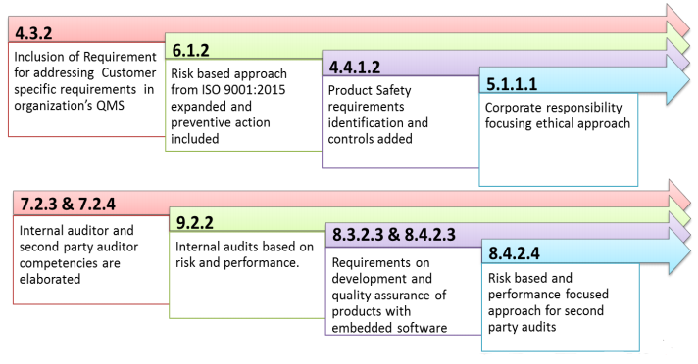
What is new in IATF 16949?

Slide 32
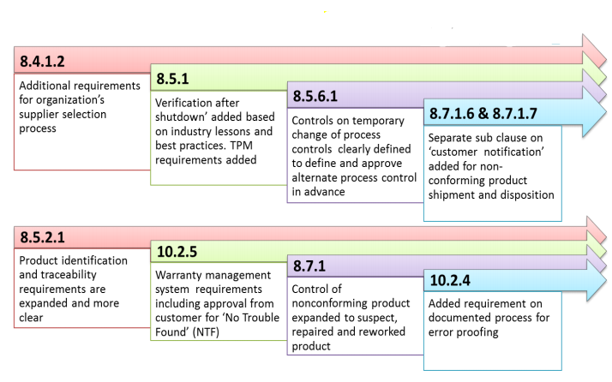
What is new in IATF 16949?

Slide 33
Transition of IATF
2015 2016 2017 March 2017: 2018
Kick off development
September 2015:
ISO 9001:2015
Standard Released
April 2016:
IATF Standard conference to review draft 16949 standard
October 2016:
Expected publication of IATF 16949
October 2017:
No further audit to ISO/TS 16949:2009
September 2018:
Full conformance with new IATF 16949

Slide 34
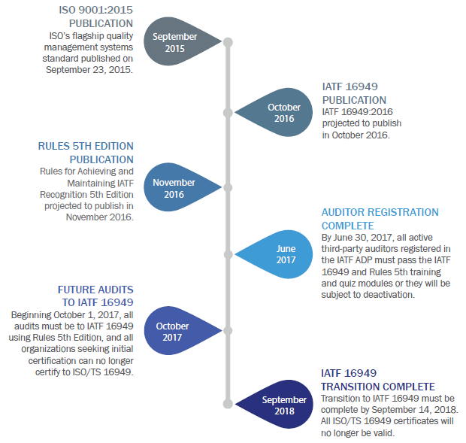
Transition of IATF

Slide 35
Why Transition to IATF 16949 : 2016?
Why transition to new automotive Standard?
Increased expectation from stake holders (OEMs, Regulatory bodies…)
Development in and emergence of new Manufacturing Technologies
Raising the bar

Slide 36
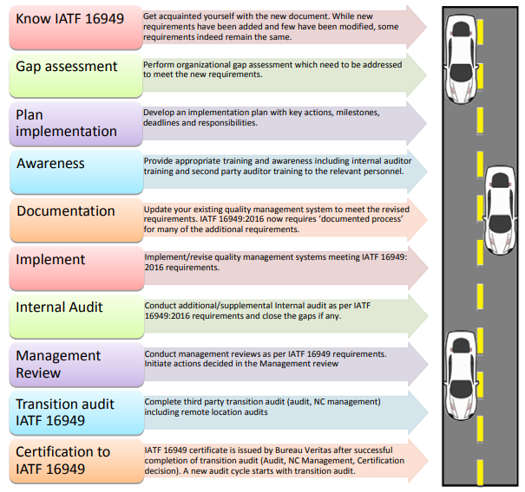
ROADMAP FOR TRANSITION TO IATF 16949:2016
We are currently certified to
ISO/TS 16949:2009
What should I do?

Slide 37
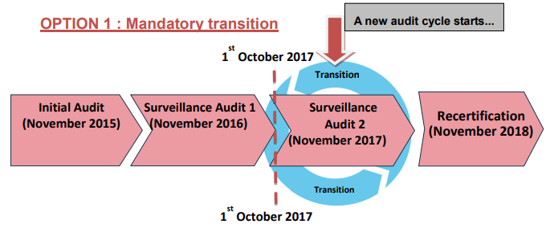
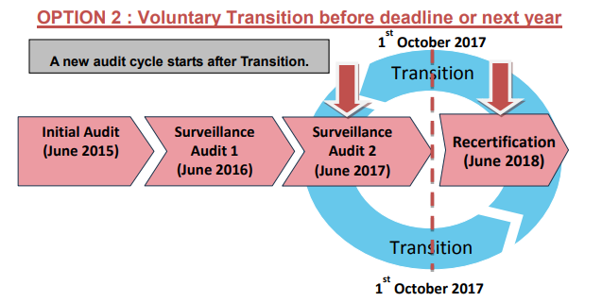
Timeframe for transition audit to IATF 16949?

Slide 38
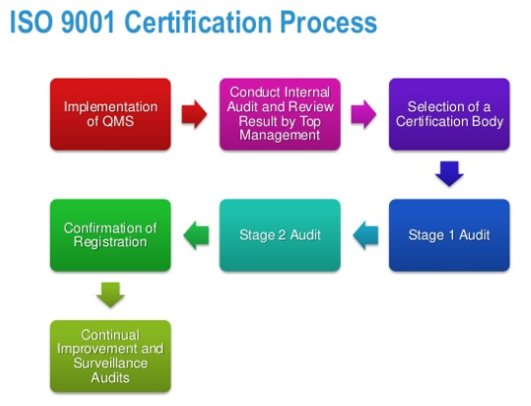
ISO 9001 Certification Process

Slide 39
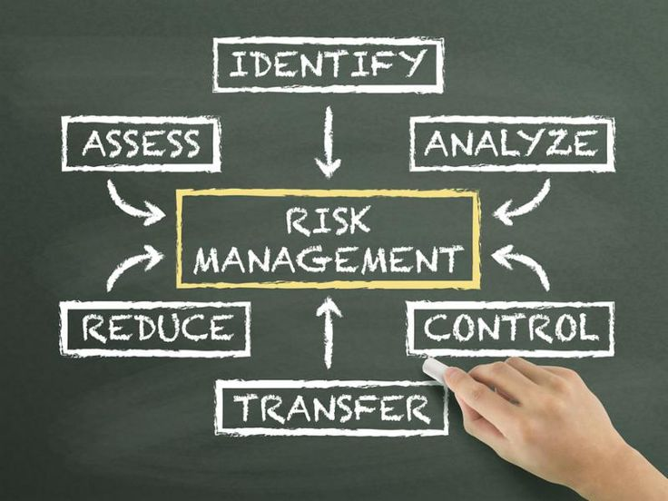
Risk Management

Slide 40
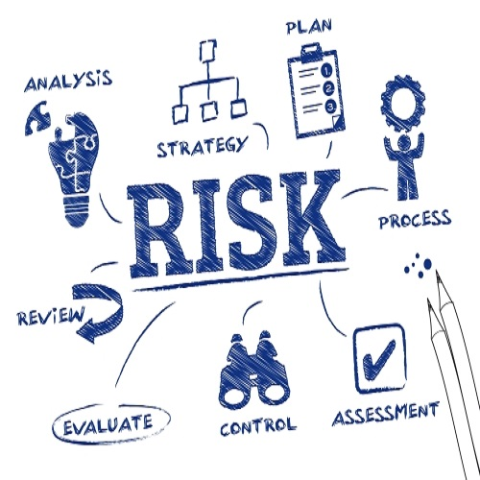
Risk Based Thinking
To minimize the likelihood of failure during new program development
To maximize the potential realization of planned activities.
To ensure risk-based thinking is pervasive throughout the organization
Top management needs to be actively engaged.
Risk-based is essential for achieving an effective quality management system.
Carrying out preventive action to eliminate potential nonconformities
To conform to the requirements of International Standard, an organization needs to plan and implement actions to address risks and opportunities.

Slide 41
Our Experience
Our Experience
A QMS involves more that HARD measures of quality
SOFT Measures
- Teamwork
- Empowerment
- Management Approach
- Working environment
- Mindset

Slide 42
Our Experience
Lessons Learnt
Shift in Management Philosophy
Culture of Continuous Improvement
Training is Key
Effective Communications
Recognition of Achievements / Motivation
Results in Improved Productivity

Slide 43
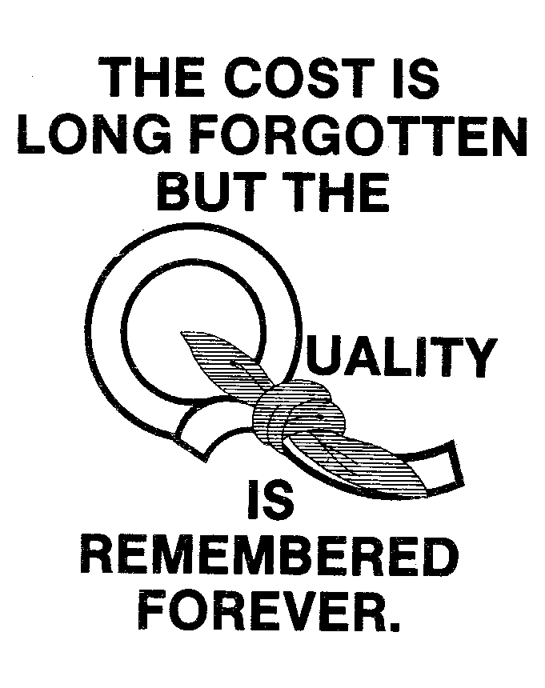
Our Experience

Slide 44
I need more information…. Where should I contact?
Certification Bodies
Local QMS Coordinator
Search through Internet and Media
Training Providing Agencies (Omnex, TUV SUD, etc.

Slide 45
Any Questions?

